Slide 1

Chinook Music Store Pranav Jayanth 2025

Slide 2

About Chinook
Chinook, a leading brand in the physical music record industry, provides entertainment to audiences worldwide. With an extensive network of international service points, Chinook offers a diverse range of music genres to cater to global tastes.

Slide 3
Problem Statement
Challenge: How can Chinook, a top brand in physical music records, optimize its global service network to effectively deliver diverse music genres and stay ahead in the competitive entertainment industry?

Slide 4

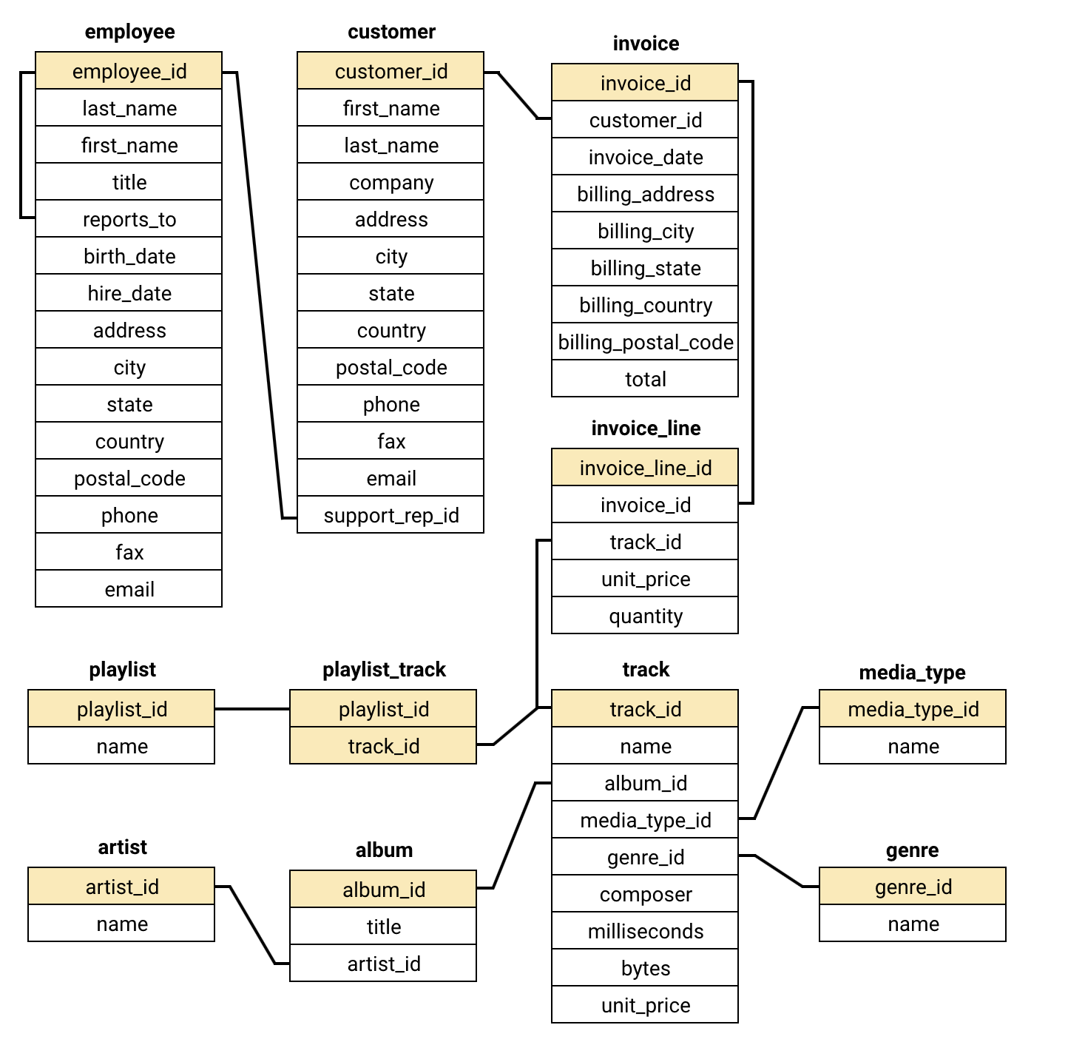
About Dataset
The dataset consists of 11 tables that capture the historical performance of the Chinook Music Store.
It includes:
251 albums,
130 artists,
25 genres, and
59 customers from 24 countries.
The Invoices table contains detailed transaction data for each customer.
The Customers table provides information about Chinook's customer base and demographics.

Slide 5
How do demographic factors such as age, gender, location, and purchasing behavior influence sales performance, and how can this data be leveraged to optimize marketing strategies and inventory decisions?

Slide 6
Demographic Analysis
North America: Primary Market
Canada and the USA represent the largest segment of Chinook's customer base.
High market penetration and strong performance in this region.
Europe & South America: Developing Markets
Expanding customer presence in key regions such as Brazil, France, Germany, and the UK.
Global Reach: Opportunities for Growth
Individual customers span across various countries worldwide.
Significant potential for expansion, with a focus on addressing diverse market demands.

Slide 7
How do sales vary across different music genres, and what insights can be drawn from these trends to guide inventory management, marketing efforts, and customer targeting?

Slide 8
Genre-Based Sales
Genre-Based Sales
Top-Selling Genres: Rock Leads the Way
Rock music accounts for over half of total sales, making it the most popular genre.
Alternative, Punk, and Metal also perform exceptionally well, showcasing strong audience interest.
Strategic Recommendations
Focus on stocking and promoting Rock, Alternative, Punk, and Metal genres.
Introduce targeted campaigns and promotions tailored to these high-demand categories to drive further growth.

Slide 9
How can Chinook identify key factors influencing revenue fluctuations across different regions and customer segments, and what strategies can be implemented to optimize sales performance and drive consistent revenue growth?

Slide 10
Revenue Analysis
USA and Canada dominate Chinook's revenue and invoice count, highlighting North America as the primary market.
Emerging Markets: Brazil, France, and Germany show promising growth, indicating strong potential for further expansion in these regions.
Opportunities for Growth: Countries like the UK, Portugal, and India have moderate revenues but could benefit from targeted marketing strategies to maximize their potential.
Smaller Markets: Nations like Chile, Australia, and European countries such as Finland and Hungary present opportunities for niche market penetration with tailored strategies.

Slide 11
What are the underlying causes of customer churn at Chinook, and how can the company reduce its churn rate by implementing targeted retention strategies to improve customer loyalty and long-term engagement?

Slide 12
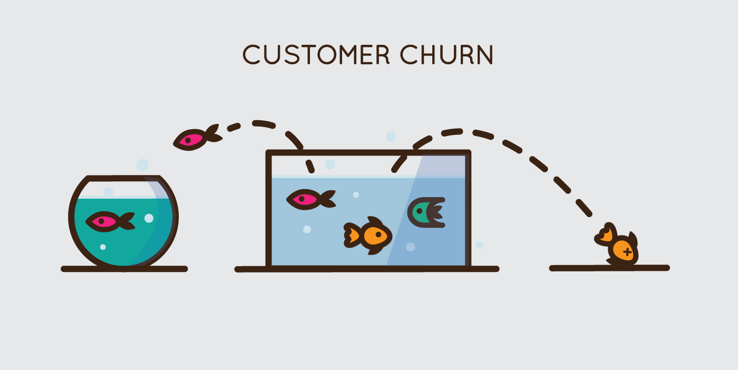
Churn Rate Analysis
Churn Rate Analysis:
Overall Churn Rate: 19.88%
Roughly 1 in 5 customers discontinue annually.
Yearly Churn Trends:
2018: 2 customers churned.
2019: 4 customers churned.
2020: 5 customers churned.
A noticeable upward trend in yearly churn suggests increasing customer attrition.

Slide 13
How can Chinook leverage product affinity analysis to identify customer purchasing patterns, uncover relationships between different products, and optimize cross-selling and upselling strategies to boost sales and enhance customer satisfaction?

Slide 14

Product Affinity Analysis
Frequent Genre Pairings: The most commonly purchased genre combinations include:
Rock & Metal (986 times)
Alternative & Punk & Rock (629 times)
Rock & Alternative & Punk (412 times)
Rock & R&B/Soul (231 times)
Blues & Rock (180 times)
Optimize In-Store or Online Displays: Based on genre affinity, organize physical or digital stores to promote albums from genres often purchased together.

Slide 15
How can Chinook accurately calculate and analyze the Customer Lifetime Value (CLV) to identify high-value customers, optimize marketing spend, and implement strategies that maximize customer retention and long-term profitability?

Slide 16
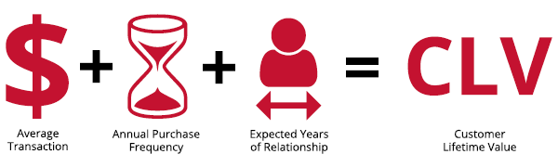
Customer Lifetime Value Analysis
USA has the highest concentration of customers with high LTV values, with notable customers like Dan Miller (31.05), Frank Harris (33.08), Frank Ralston (33.22), and Michelle Brooks (31.38) contributing significantly to the total revenue.
Canada follows closely behind, with customers like François Tremblay (35.92) and Emma Jones (31.39) showcasing high LTV.
Other countries with notable LTV figures include France (e.g., Camille Bernard (27.85), Dominique Lefebvre (30.69)) and Brazil (e.g., Alexandre Rocha (18.47), Eduardo Martins (17.03)).
Some countries have lower LTV values, such as Argentina (e.g., Diego Gutiérrez with 17.53), Denmark (e.g., Kara Nielsen with 11.19), and Netherlands (e.g., Johannes Van der Berg with 18.74). These countries might have customers who either:
Churned early, or
Do not engage as frequently.

Slide 17
Recommendations
High-Value Areas (USA, Canada, France):
Exclusive Products and Premium Pricing: Consider offering exclusive or premium products to customers in these high-LTV countries.
Loyalty and Retention Programs: For customers with consistently high LTV, create personalized loyalty programs that reward long-term engagement and high-frequency purchases.
Targeted Marketing Campaigns: Given the high potential of customers in these regions, implement targeted marketing efforts that highlight the value and benefits of being a loyal customer.
Churn Analysis and Retention Strategies: Deep dive into churn reasons in these areas. Is it due to customer dissatisfaction, high competition, or a lack of personalized offers?
Customer Feedback: Gather feedback via satisfaction surveys or direct outreach to understand the barriers to purchase and develop retention strategies.
Discounts or Offers: Implement discounts, bundled offers, or better customer service to incentivize customers in these regions to return.

Slide 18
Conclusion
1.Enhance Customer Loyalty:
Introduce loyalty programs and personalized marketing campaigns.
2.Focus on High-Value Customers:
Offer exclusive benefits to reward and retain long-term customers.
3.Improve Data Accuracy:
Maintain high-quality data to ensure reliable analysis and decision-making.
4.Implement Targeted Campaigns:
Design region-specific marketing strategies to address diverse customer needs.
5.Expand Customer Insights:
Collect demographic data to enable more precise audience targeting.

